Slide 1
Sept 10th
Olivia
Doherty
Citizenship 9
Insert some kind of cool picture here

Slide 2
TABLE OF CONTENTS
TABLE OF CONTENTS
WHERE
1
2
3
4
Personal
Community
Global
Aspirational

Slide 3
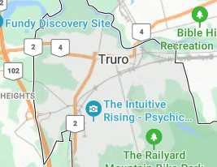
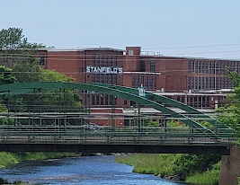
The Personal Place
Cit 9 WHERE
MAP SCREENSHOT (from Bing Maps) | Reflection: im not sure where in Truro but when i was younger my family and i would go to tim hortons then head over to Truro and go to my aunts house. I enjoyed going over because her house was like a farmhouse with animals in the front and backyard, like chicken, roosters, lambs, and goats. Me and my siblings would go in the backyard and run with the goats. Once the goats ran out the gate and we had to get the baby and mother goat back in the yard. | IMAGE
Notes:
The Personal Place
Reflection: Write a paragraph about a personal place that holds significance for you.
Guiding Questions:: In a second section, describe how your personal perspective shapes the way you see and feel about this place. What stories or memories are tied to this specific location?

Slide 4
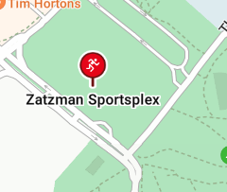
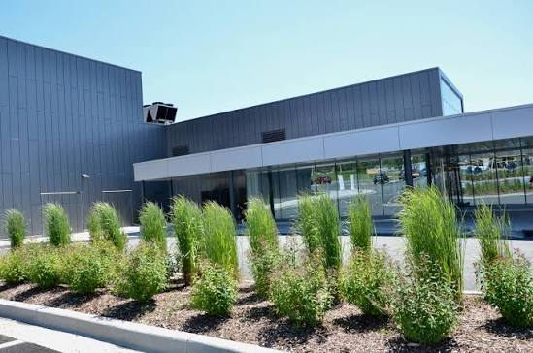
The Community Place
Cit 9 WHERE
 | My dad would take me and my siblings down to the zatzman sportsplex everyday in the summer in 2024 we would swim for hours everyday and we would meet our friends at the pool and play games in the water and go down the slides. After we would go in the hot tub but after the cold pool the hot tub is super hot like boiling i would feel like i was gonna die as i slowly got in. | IMAGE
Notes:
Reflection: Write about a significant place in our local community. Tell the story of the place! Who owns it? Why do you like it? Describe something that happened there that you remember.

Slide 5
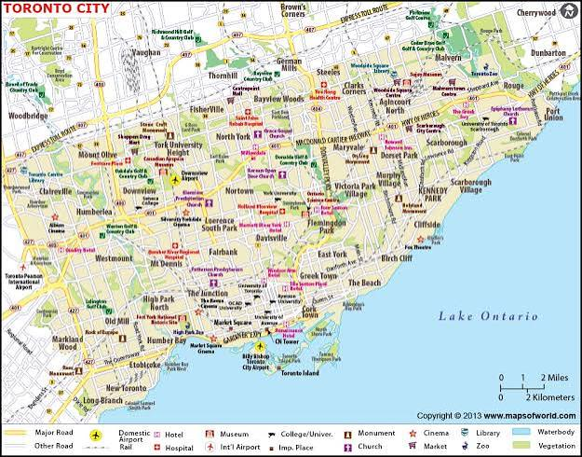
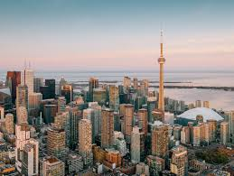
The Global Place
Cit 9 WHERE
MAP SCREENSHOT | Reflection: i don't really know alot about this place but most of my family are from toronto, and always come down to stay with us for holidays. | IMAGE
Notes:
Reflection: Write a story about a place in the world that is part of your family's story.
Guiding Questions: Tell the story of how you and/or your family are connected to this place.
What traditions or values from this place have been passed down to you?
How does this connect to your cultural identity, including things you do and who you are?

Slide 6
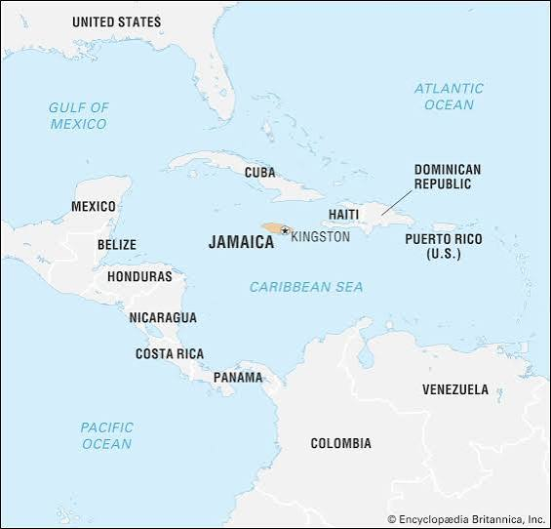
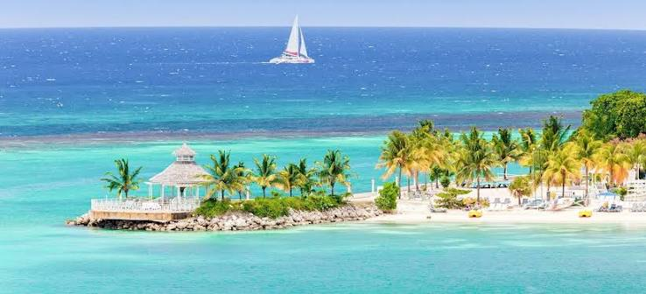
The Aspirational Place
Cit 9 WHERE
MAP SCREENSHOT | Reflection: i would love to go to jamaica for the pretty water that i would swim in, and when i have kids we will go there every summer or spring because its just so pretty and probably nice and warm. Guiding Questions: i would like to go the jamaica because i like how nice and pretty, blue, and crystal clear water is. | IMAGE
Notes:
Reflection: Write a story about a place in the world that is part of your family's story.
Guiding Questions: What draws you to this place? What do you hope to learn or experience there? How does this place fit into your hopes for the future?

Slide 7

The Aspirational Place
Cit 9 WHERE
Soundtrack of your life | Post the youtube link here https://www.youtube.com/results?search_query=baby Justin Bieber - Baby ft. Ludacris | Me and my childhood friend named maddie would sing this song everyday at recess, and we would scream and run. But she moved away from the school and she tried to come back this year but i don't think she can because the principal won't give her parents a call back to be in this school.
Notes:
Reflection: Write a story about a place in the world that is part of your family's story.
Guiding Questions: What draws you to this place? What do you hope to learn or experience there? How does this place fit into your hopes for the future?

Slide 8
THANK YOU

